Slide 1
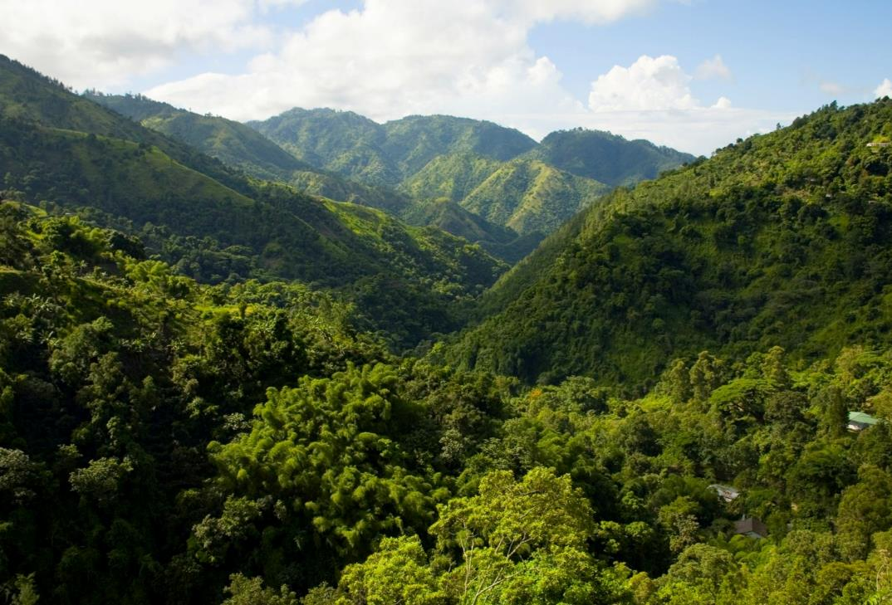

MARKETING DESTINATION JAMAICA:
Market Nuances, Managing the Message & Media

Slide 2
2016 ACHIEVEMENTS – JAMAICA HOUSE
JAMAICA HOUSE VIDEO

Slide 3
2016 ACHIEVEMENTS – UK
UK VIDEO

Slide 4
2016 ACHIEVEMENTS – THE AMERICAS
JAMAICA SIZZLE REEL

Slide 5
2016 ACHIEVEMENTS – ARRIVALS

Slide 6
2016 ACHIEVEMENTS – ARRIVALS

Slide 7
2016 ACHIEVEMENTS – ARRIVALS

Slide 8
EVENTS & THE MARKETING MIX
HOW IMPORTANT ARE EVENTS TO JTB?
MARDI GRAS
CARNIVAL
1M+ VISITORS IN 2015
6.8M VISITORS IN 2015
ART BASEL
$500M TO LOCAL ECONOMY
COACHELLA
OKTOBERFEST
$403M FOR LOCAL BUSINESS
5-6M VISITORS ANNUALLY

Slide 9
EVENTS & THE MARKETING MIX
HOW IMPORTANT ARE EVENTS TO JTB?
Build brand awareness
Encourage visitor arrivals
Provides USP & positioning
Enhance visitor experience
Supports community

Slide 10
EVENTS & THE MARKETING MIX
HOW IMPORTANT ARE EVENTS TO JTB?
Every destination needs one or more hallmark events to provide high levels of media exposure and positive imagery to help create competitive advantages.
Event Management & Event Tourism, David Getz, 1997

Slide 11
MARKET PROFILE - USA
Consumer Travel Profile
42% of Americans expect to travel for leisure in 2017. Up from 32.2% mid-2016
60% of US travellers are price driven
Wellness travel growing 50% faster than regular travel
Spring breakers are looking for adventure and steering away from past popular destinations
Safety concerns are keeping Millennials from traveling more

Slide 12
MARKET PROFILE - CANADA
Consumer Travel Profile
Weak Canadian economy continues to impact travel plans
Off-the-beaten-path wonders top Canadians travel wish list for 2017
Most interested in travelling to beach destinations, visiting major cities and multi-generational travel
75% of Millennial Canadians named social experiences as top reason for travel
Nature and cultural experiences hold strong appeal
“Once in a lifetime” event such as wedding and honeymoon is compelling reason to travel

Slide 13
MARKET PROFILE – LATIN AMERICA
Consumer Travel Profile
Increase in incomes, longer working hours and increasing consumer choice have LatAm professionals and urban middle-class time pressed
Authentic destination experiences in high demand
Latin Americans travel mainly for leisure, recreation and holidays and enjoy activities such as shopping and dining out
Latin Americans are traveling more internationally and spending more than ever before
As a group they are making a shift away from flashy, ostentatious luxury to more experiential adventures
89% of internet users in Latin America use Facebook
66% of Latin Americans use WhatsApp versus 33% of Europeans and only 7% of North Americans (Global Web Index)

Slide 14
MARKET PROFILE – UK
Consumer Travel Profile
Women influence 85% of all purchasing decisions and account for 58% of online sales
58% of young adult Britons are making working less a priority and 52% are focused on travelling more
Financial security and empty nests make the Baby Boomers an important target for travel
40% of travellers book long-haul travel 5 months ahead
Value-for-money increasingly important due to Brexit currency fluctuations

Slide 15
MARKET PROFILE – GERMANY
Consumer Travel Profile
3rd oldest country in the world based on avg population age
Low birth rate, increasing life expectancy and aging population
Sustainability and good health are important considerations
Travel for nature, engaging with locals, learn/explore and lifestyle
Increasingly using travel website in the decision making process

Slide 16
GLOBAL TRAVEL TRENDS
'Microadventure' growing travel trend among UK travellers
Big travel brands (TripAdvisor, Airbnb, Expedia) are booking tours & activities
Festivalisation of meetings emerging trend
Sustainable tourism taking centre stage
Travellers are demanding authentic experiences
Restaurants are becoming destinations themselves
More people would rather spend on travel experiences than material objects

Slide 17
LEVERAGING SPECIAL EVENTS
ATTRACT MEDIA ATTENTION
POSITION DESTINATION
BUILD MARKETS
BUILD BRAND AWARENESS
ATTRACT VISITORS

Slide 18
PROMOTING EVENTS
JTB social media channels
Traditional media
JTB sales team
Social media influencers

Slide 19
PROMOTION WINDOW
29%
45%
38%
NORTH AMERICANS
LATIN AMERICANS
EUROPEANS
Percentage of travellers booking travel 60+ days out

Slide 20
APPLICATION PROCESS
3 MTHS
3 MTHS
1 MTH
BOOKING WINDOW
PROMOTION
EVENT APPLICATION
MIN 7 MONTH LEAD TIME

Slide 21
TIPS FOR SUCCESS
Appealing concept
Well conceived flow & execution plan
Effective marketing plan
Sufficient planning schedule
Well timed
Clear details
Tracking mechanism and data collection

